Slide 1

Data Analytics
CS390
Modeling: Formal Basics
Fall 2017
Oliver Bonham-Carter
https://github.com/rstudio/Intro

Slide 2

What does it mean to regress Y on X?
A function defines one variable in terms of another.
The statement "y is a function of x" (denoted y = y(x)) means that y varies according to whatever value x takes on.
A causal relationship is often implied (i.e. "x causes y"), but does not *necessarily* exist.

Slide 3
Extracting Info
Create model object to look for “What If?” patterns.
Run functions on model object to get details
Try these commands
summary(mod)
predict(mod) # predictions at original vals
resid(mod) # residuals

Slide 4
Let’s Hit the Code
#plot the data
crime %>% ggplot(aes(x = low, y = tc2009)) + geom_point(alpha = I(1/4)) + geom_smooth(method = lm)
crime %>% ggplot(aes(x = low, y = tc2009)) + geom_point(alpha = I(1/4)) + geom_smooth()
#Build the model
mod1 <- lm(tc2009 ~ low, data = crime)

Slide 5
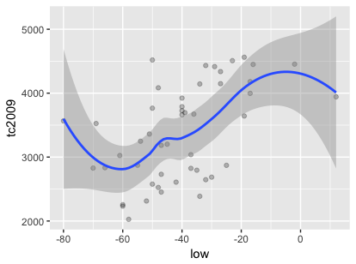
Plots
crime %>% ggplot(aes(x = low, y = tc2009)) + geom_point(alpha = I(1/4)) + geom_smooth()

Slide 6
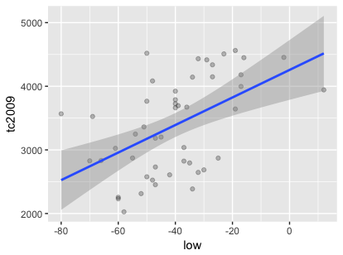
Plots
crime %>% ggplot(aes(x = low, y = tc2009)) + geom_point(alpha = I(1/4)) + geom_smooth(method = lm)
This
is
the
model’s
line
here!

Slide 7
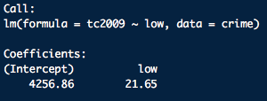
Build A Model
To Play With
mod1 <- lm(tc2009 ~ low, data = crime)

Slide 8
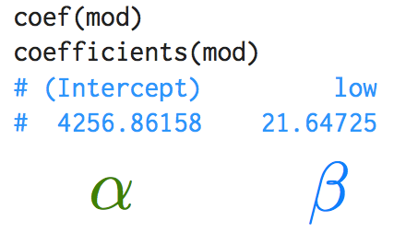
Coef
Shows the model’s coefficients (I.e., intercept, slopes)

Slide 9
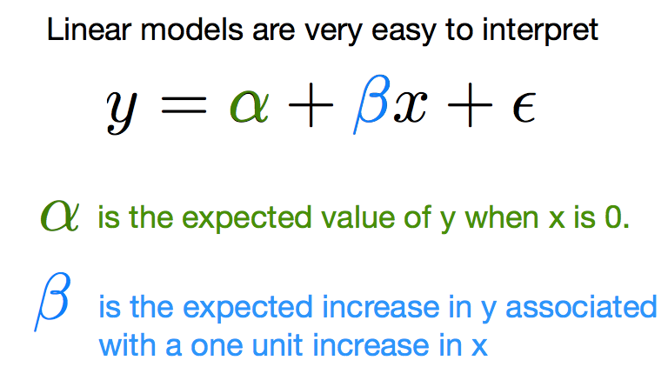
Interpreting Models
Page 32

Slide 10
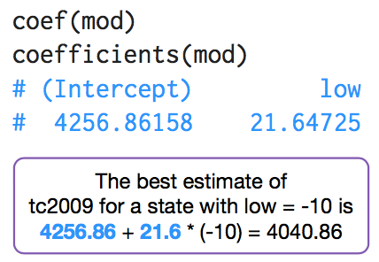
Coef
(x,y) ← (-10, 4040.86)

Slide 11
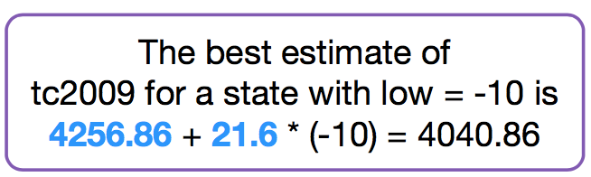
Coef Calculator
This function is now my data!!
# create function to find y for x
tellMeY <- function(x_int){
#function to get the y value for an entered x value
# The best estimate of tc2009 for a state with low of inputted value x_int
cat(" intercept :",mod1$coefficients[1] )
cat("\n slope :",mod1$coefficients[2] )
y = mod1$coefficients[1] + x_int * mod1$coefficients[2]
cat("\n y = ",y)
}
tellMeY(-10) # note: x = -10 also, my “what if?” enabler
Due to error,
there is a
slight
difference
between this
and our
value.

Slide 12
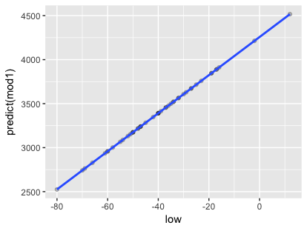
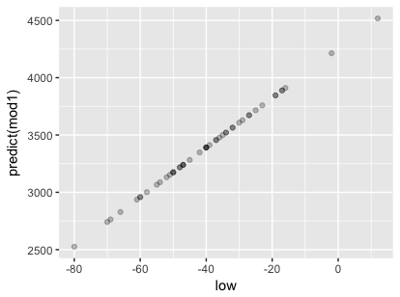
The Model’s Line
crime %>% ggplot(aes(x = low, y = predict(mod1))) + geom_point(alpha = I(1/4))
crime %>% ggplot(aes(x = low, y = predict(mod1))) + geom_point(alpha = I(1/4)) + geom_smooth()

Slide 13
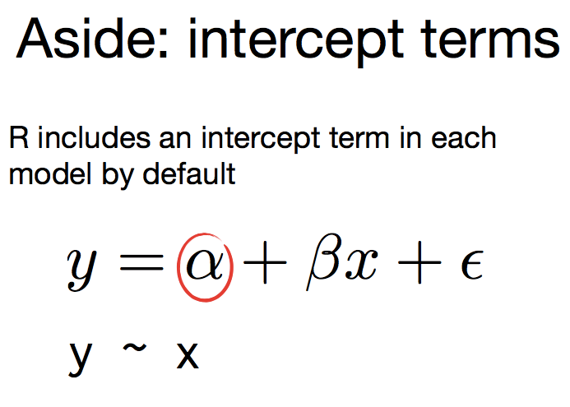

Slide 14
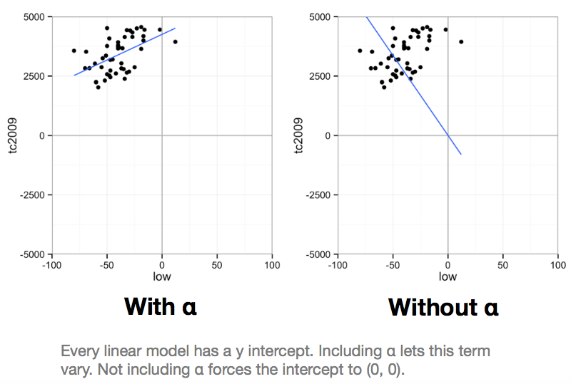
Want the Zeros or Not?

Slide 15
An Intercept Term:
To Use or Not?
You can explicitly ask for an intercept by including the number one, 1, as a formula term. You can remove the intercept by including a zero or negative 1.
# equivalent - includes intercept
lm(tc2009 ~ 1 + low, data = crime)
lm(tc2009 ~ low, data = crime)
# equivalent - removes intercept
lm(tc2009 ~ low - 1, data = crime)
lm(tc2009 ~ 0 + low, data = crime)

Slide 16

Now, Back to Our Question...
Do you think that
taller people make
more money?
File: wages.csv
Remember:
It’s not you, it’s your data.

Slide 17

Consider This!
Fit a linear model to the wages data set that predicts earn with height.
How do you interpret the relationship
between height and earnings?
wages <- read.csv("wages.csv")
hmod <- lm(earn ~ height, data = wages)
hmod <- lm(earn ~ height, data = wages)

Slide 18


Dep And Indep Vars
#make your model
hmod <- lm(dependent ~ independent)
Where dependent var is earn
And independent var is height

Slide 19
Earn Regressed Over height
#make your model
hmod <- lm(earn ~ height)
Where dependent var is earn
And independent var is height

Slide 20
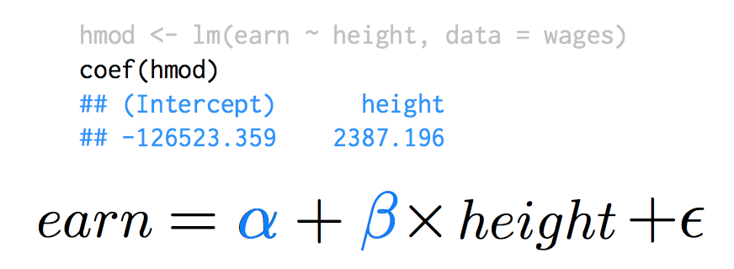
Earn Regressed Over height

Slide 21
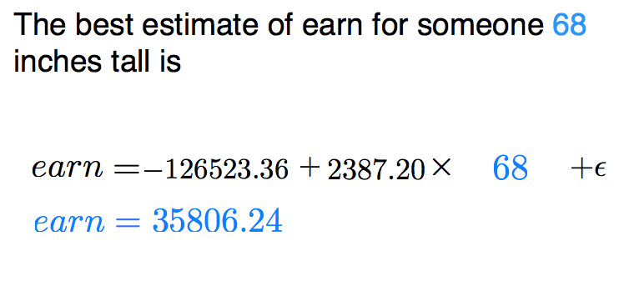
Earn Regressed Over height

Slide 22
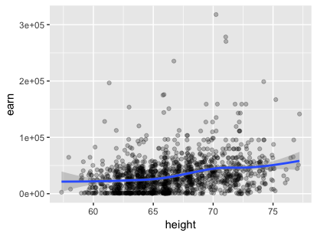

Do Tall People Make More?
wages %>% ggplot(aes(x = height, y = earn)) + geom_point(alpha = I(1/4)) + geom_smooth()
wages %>% ggplot(aes(x = height, y = earn)) + geom_point(alpha = I(1/4)) + geom_smooth(method = lm) # regression line

Slide 23
Build a model.
Fit a linear model to the wages data set
How do we interpret the results?
Q: What happens when
we regress earn over race?

Slide 24
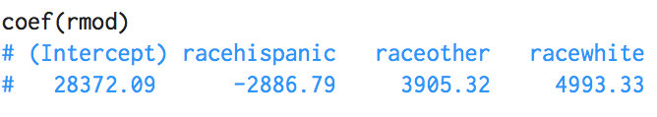
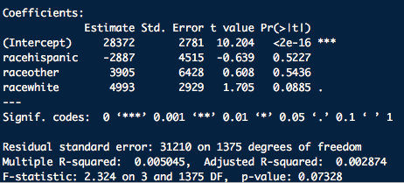
Header
rmod <- lm(earn ~ race, data = wages)
coef(rmod) # get the model’s y-intercepts and slopes
summary(rmod)

Slide 25
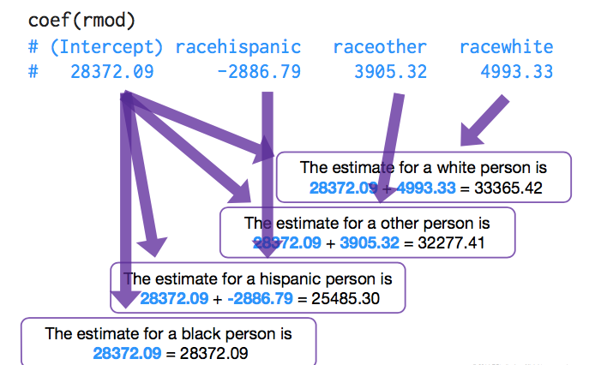
Estimates From Coefficients
Page 84 of slides

Slide 26
Header
This

Slide 27
Consider This!
Fit a linear model to the crime data set.
Predict tc2009 (dep) with low (ind). What function describes the best fit line?
Y = ? + ? * x + ϵ
mod <- lm(tc2009 ~ low, data = crime)
mod <- lm(tc2009 ~ low, data = crime)

